Slide 1
The Business Case for Religious Freedom
Notes:
This work includes working with some top experts, like Kent Johnson, who was Senior Council here at Texas Instruments for many years, as well as the Religious Freedom Center of the Freedom Forum Institute in Washington DC.

Slide 2
The Business Case for Religious Freedom
Brian Grim, Ph.D.
President, Religious Freedom & Business Foundation
Senior Fellow, Freedom Forum Institute
Notes:
The Religious Freedom Center of the Newseum Institute is a nonpartisan national initiative focused on educating the American public about the religious liberty principles of the First Amendment.

Slide 3
Religious Freedom Spurs Global Economy
Religious Freedom

Slide 4
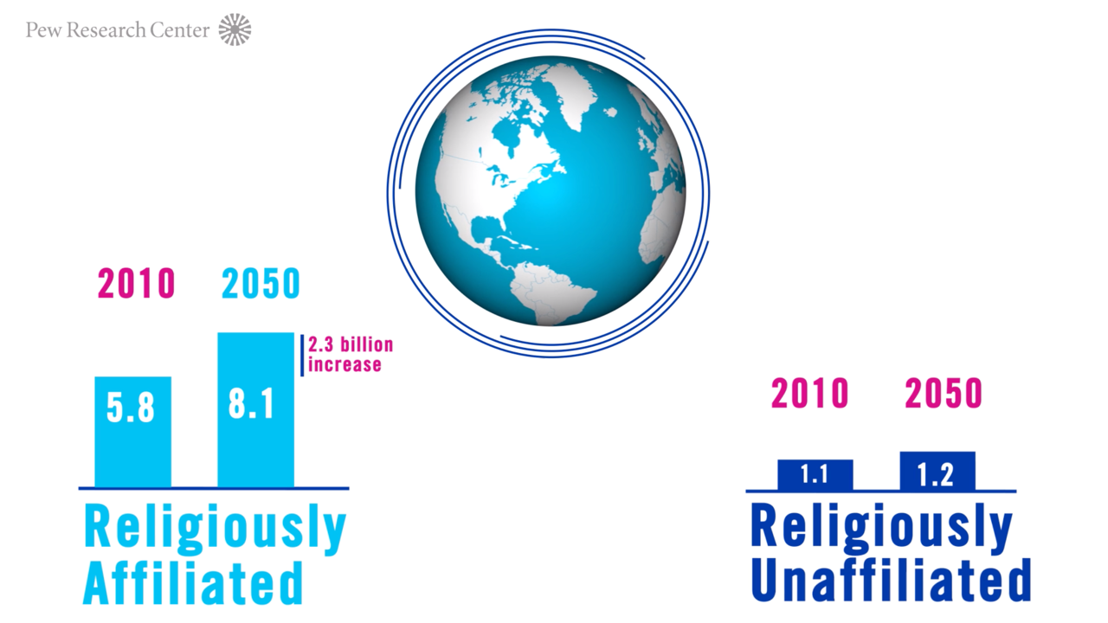
Notes:
When I led the international data project at the Pew Research Center from 2008-2014, we projected that our planet will have 2.3 billion more religiously affiliated people by 2050 compared with just 0.1 billion more religiously unaffiliated people.

Slide 5
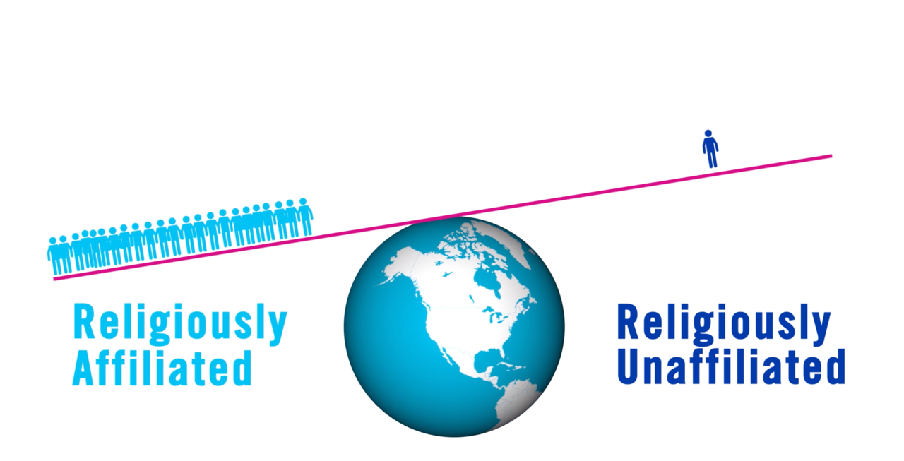
Notes:
That’s like religion “winning” 23-to-1.

Slide 6
Notes:
This religious growth is changing the global marketplace. Today, three of the top five economies are Christian-majority.

Slide 7
Notes:
But in 40 years, only one is projected to be. The other four top economies in 2050 will include countries where Hindus, Muslims, Buddhists and the unaffiliated predominate.
Research shows that this religious growth can be good for the workplace and the bottom lines of businesses – as long as restrictions on freedom of religion or belief are kept low.
In such countries, innovative strength is more than twice as high as in countries where governments and societies don’t respect freedom of religion or belief. So, freedom to believe – or not believe – is good for business, as I’ll come back to in a moment.
But the data on respect for freedom of religion or belief in the U.S. and worldwide are very concerning.

Slide 8
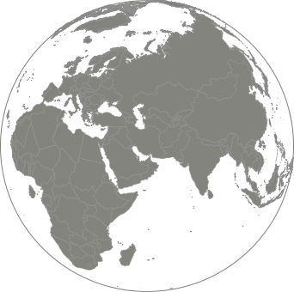
Restrictions on Freedom of Religion or Belief
40%
of countries have high restrictions
Notes:
Annual studies that I initiated while at the Pew Research Center find that restrictions on religion and belief are high or very high in 40% of countries.

Slide 9
Restrictions on Freedom of Religion or Belief
78.5%
5.9 Billion People live with high restrictions
Notes:
But because some of these countries (like China) are very populous, some 5.9 billion people (nearly 80% of the world’s population) live in countries with a high or very high level of restrictions on religion.

Slide 10
Restrictions on Freedom of Religion or Belief
Billions of People
5.9
4.8
1.1 B
Increase
2009
2017
Notes:
Since 2009, the number of people living in countries with high religious restrictions and hostilities has increased from 4.8 to 5.9 billion people – that’s an increase of 1.1 billion more people living in countries where freedom of religion or belief is under duress, based on studies from the Pew Research Center.

Slide 11
Restrictions on Freedom of Religion or Belief
Governments
Groups in Society
Notes:
The restrictions come from two main sources: the actions and policies of governments, and the social hostilities involving religion coming from people and groups in societies.

Slide 12
Restrictions on Freedom of Religion or Belief
Groups in Society
Notes:
So, what are examples of social hostilities involving religion?

Slide 13
Restrictions on Freedom of Religion or Belief
Groups in Society
Notes:
These include attacks on places of worship, such as the recent murders in a California synagogue and last fall’s massacre in at Pittsburg synagogue.

Slide 14
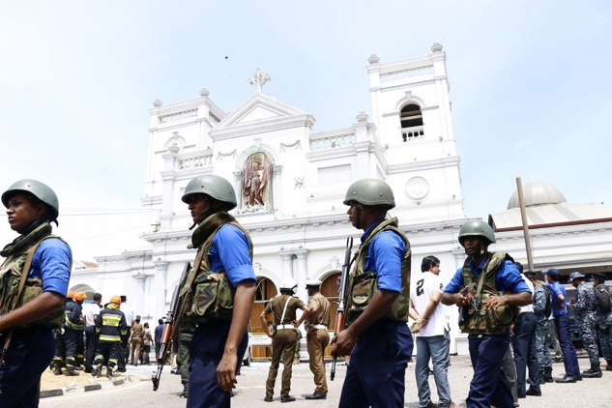
Restrictions on Freedom of Religion or Belief
Groups in Society
Notes:
Social hostilities involving religion include the recent Easter Sunday bombings of churches in Sri Lanka that left hundreds dead and as many or more injured.

Slide 15
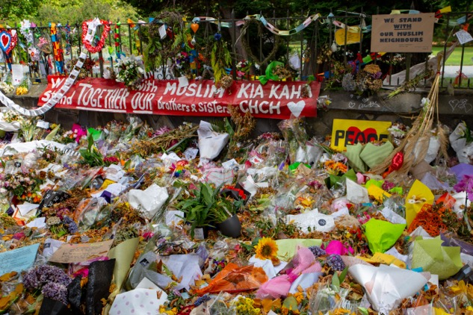
Restrictions on Freedom of Religion or Belief
Groups in Society
Notes:
They include the recent Friday prayer massacres in two New Zealand mosques.

Slide 16
Restrictions on Freedom of Religion or Belief
Groups in Society
Notes:
Such hostilities also include attacks motivated by religious hatred to people with no religious beliefs, such as Alexander Aan, an Indonesian who was beaten by a mop for declaring himself and Atheist, and then jailed by police for two years because in Indonesia blasphemy is a crime.
This case shows the frequent close connection between religiously biased laws and social hostilities involving religion.

Slide 17
Restrictions on Freedom of Religion or Belief
Governments
Notes:
Now let’s turn to examples government restrictions on freedom of religion or belief.
I’ll give some examples from China, because some of the same policy perspectives it has on religion are paralleled in some of its economic and security policies.

Slide 18
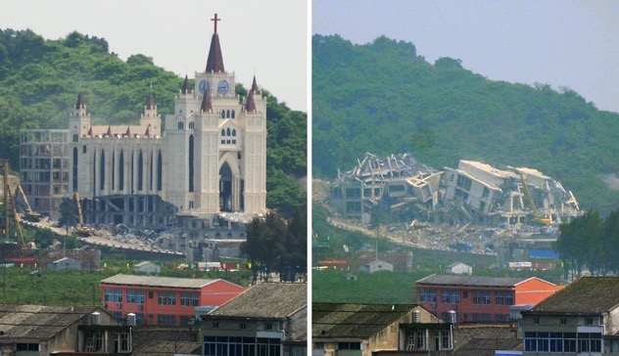
Restrictions on Freedom of Religion or Belief
Governments
Notes:
China has been on a several year campaign to not only remove crosses from churches and Christians from churches, but also church buildings from existence, such as the recent demolition of a church in Wenzhou, seen in these 24-hour before-and-after photos.

Slide 19
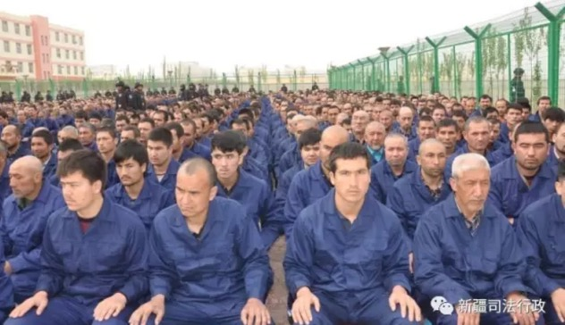
Restrictions on Freedom of Religion or Belief
Governments
Notes:
In China’s far west, up to one million mostly Uygur Muslims have been forced into re-education camps in the government’s attempt to stamp out the possibility of Islamic radicalization.
Two of my four kids were born in this region back in the 1980s, by the way.

Slide 20
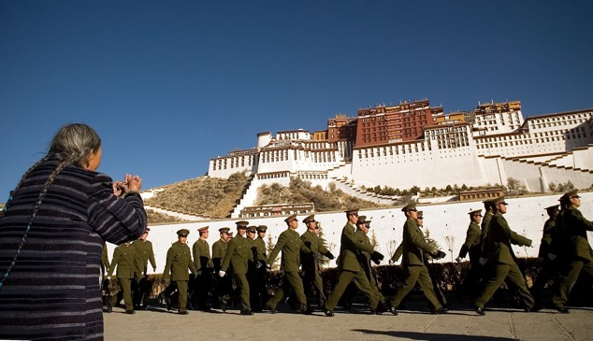
Restrictions on Freedom of Religion or Belief
Governments
Notes:
And in Tibet, prison sentences are given just for possessing a picture of the Dali Lama, who us considered a political threat by the Chinese government.
Unfortunately, while China has one of the most developed programs of restricting religion and belief, it is far from alone.

Slide 21
Restrictions on Freedom of Religion or Belief
Governments
Notes:
The example of Hamza Kashgari, who was a Saudi blogger, shows how government policies in one place can cross borders. He tweeted some doubts about his faith, which is considered blasphemy.
He fled to Australia to escape social cries for his beheading, only to be intercepted as he changed planes in Kuala Lumper, Malaysia, and extradited back to Saudi Arabia at the request of the Saudi government.
After some jail time helped him overcome his doubts, he was released.

Slide 22
Restrictions on Freedom of Religion or Belief
Governments
Groups in Society
Notes:
All this research has shown that restrictions on freedom of religion or belief coming from governments and groups in society reinforce each other and is a primary factor causing religions related violence.
All of that is generally bad for business. Specifically, research I did while working with the World Economic Forum shows that high restrictions on freedom of religion or belief damage or even destroy the pillars of global competitiveness.

Slide 23
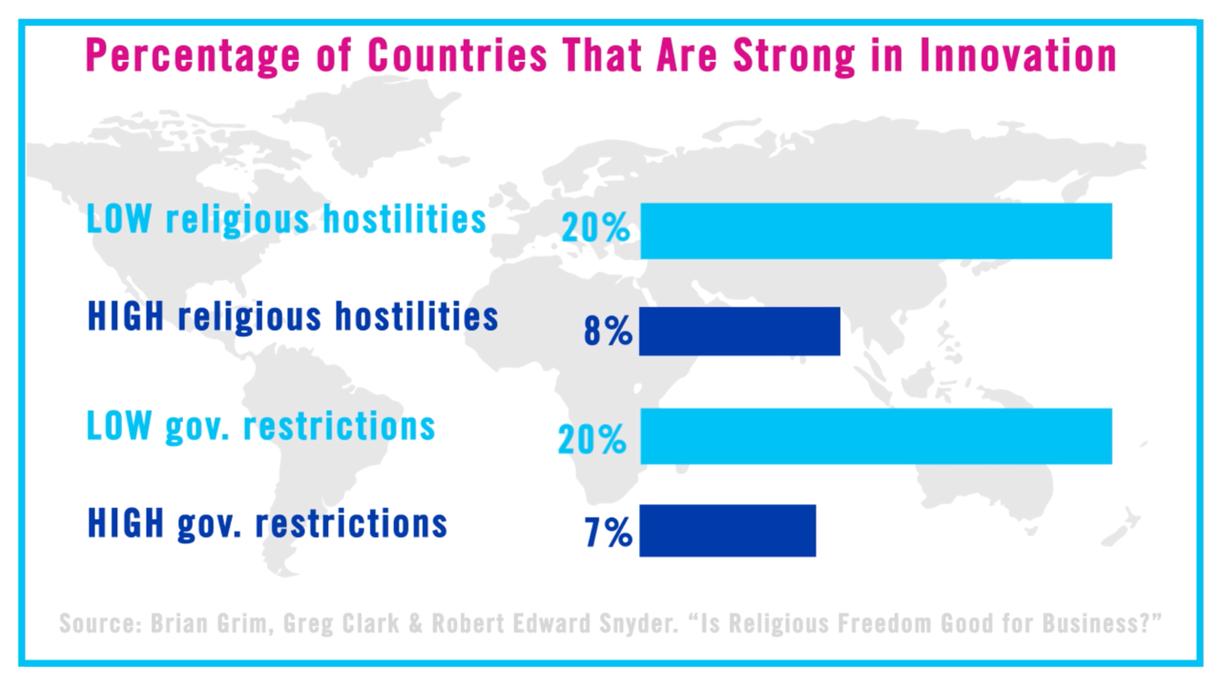
Notes:
For example, as I mentioned a few minutes ago, innovative strength is more than twice as high in countries where governments respect freedom of religion or belief.
One indicator of that is whether some of a country’s top entrepreneurs and successful business people stay in a country or leave it.

Slide 24
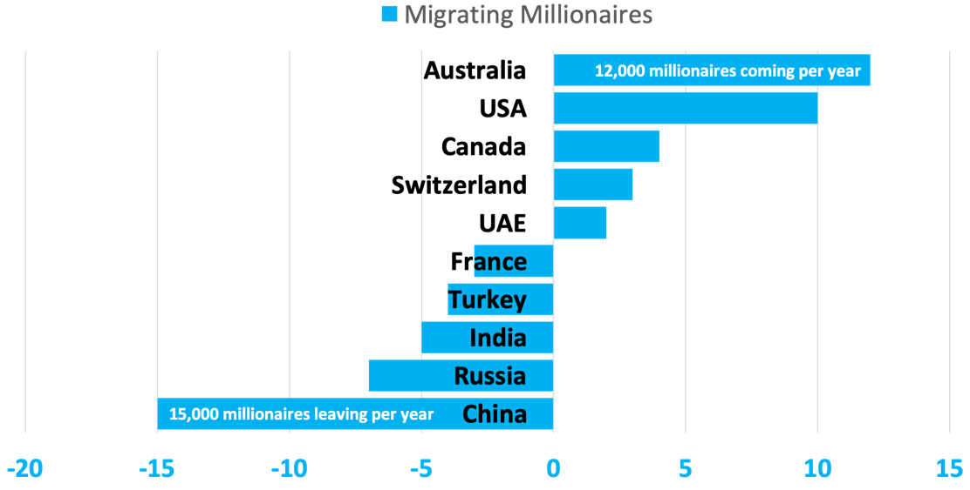
Net Loss or Gain of Millionaires (1000s)
Notes:
Bloomberg just published research showing which countries are losing or gaining millionaire through migration, with Australia gaining the most and China losing the most.
How does this compare with the level of government restrictions on religion and belief in a country?

Slide 25
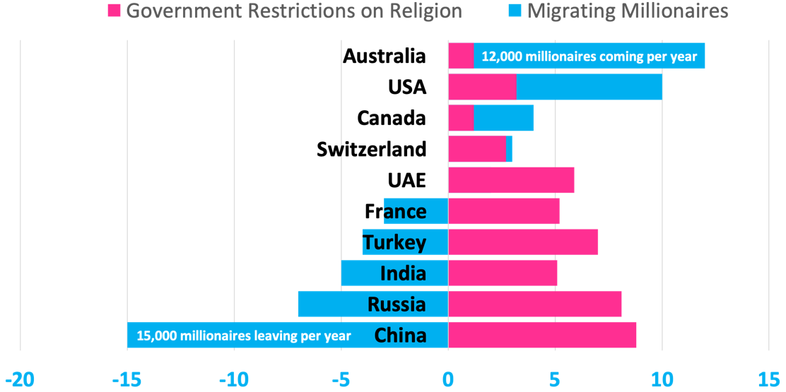
Net Loss or Gain of Millionaires (1000s)
vs. Level of Government Restrictions on Religion
Notes:
As I mentioned, it’s not surprising that China, the country with the highest government restrictions on religion – as measured by the Pew Research Center – is also losing the highest number of millionaires seeking freer, more secure opportunities elsewhere.
And Australia, a country with low government restrictions on religion, is benefiting the most from this migration of talent and resources.
While the U.S. has relatively moderate government restrictions, it has high social hostilities, according to the past three annual reports by the Pew Research Center.
One place we see this is in the number of American workers who have experienced or witnessed religious discrimination in their workplace.

Slide 26
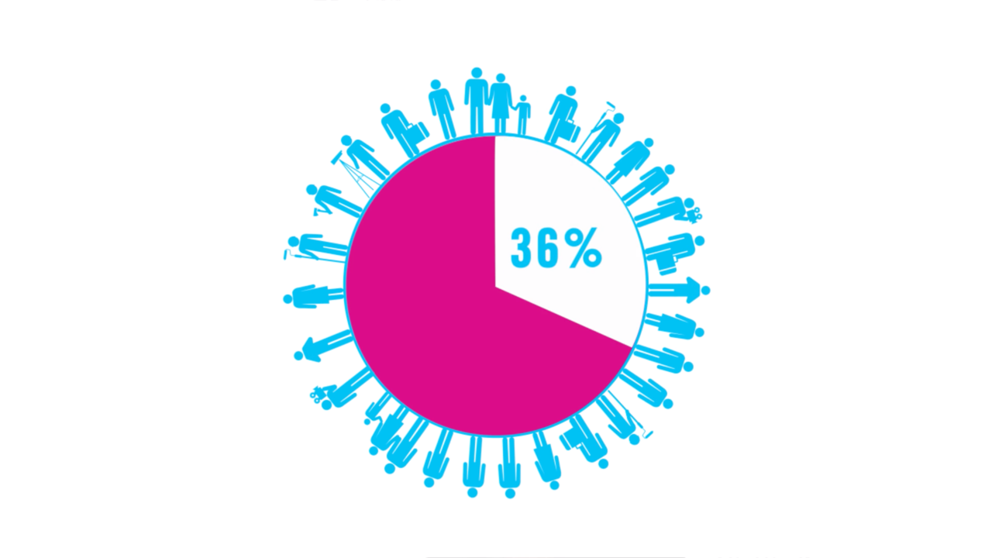
Notes:
A recent Tanenbaum survey finds that 36% of American workers, or about 50 million people, have experienced or witnessed some form of religious discrimination or non-accommodation in their workplace.
Despite this, religious diversity and inclusion is not on the minds of many companies.

Slide 27
Notes:
Companies have rightly paid a lot of attention to other diversity and inclusion issues, such as sexual orientation.

Slide 28
Notes:
Now, religion is the next big thing businesses need to pay attention to.

Slide 29
EEOC Workplace Discrimination Complaints
2018
Notes:
In 2018, for instance, there were significantly more workplace discrimination complaints made to the EEOC over religion as complaints over sexual orientation.

Slide 30
What are some companies doing?
Notes:
The same business case that applies to other characteristics applies to including religion as part of diversity and inclusion initiatives.
So, what are some of the religious D&I initiatives of major U.S. and international corporations? I’ll give just a few examples.

Slide 31
What are some companies doing?
Notes:
The same business case that applies to other characteristics applies to including religion as part of diversity and inclusion initiatives.
So, what are some of the religious D&I initiatives of major U.S. and international corporations? I’ll give just a few examples.

Slide 32
Notes:
As we’ve heard today, this year Texas Instruments’ Diversity Network celebrates 30 years of diversity leadership and trailblazing.
TI was one of the early pioneers of instilling diversity into its corporate culture, embracing the premise that a diverse employee base is likely to facilitate fresh and valuable ideas; and that employees perform at higher levels when they’re permitted to “bring their whole selves to work”.
Today the company has 15 grassroots, employee-led diversity resource groups that help foster and support a diverse and inclusive work environment, including faith-oriented groups for Christian, Jewish and Muslim employees.

Slide 33
Notes:
For the third year in a row, Bloomberg is hosting Tanenbaum’s Religious Diversity Leadership Summit, cosponsored by DTCC and the Walt Disney Company. The summit explores what’s next in addressing religious diversity & inclusion.

Slide 34
Notes:
Last year, during the National Day of Prayer, Accenture hosted an opt-in virtual internal prayer event with employees from their various faith-oriented Employee Resource Groups leading prayers – including a humanist reflection – for our country. Accenture has pioneered in both faith-specific and interfaith Employee Resource Groups.

Slide 35
Salesforce

Slide 36
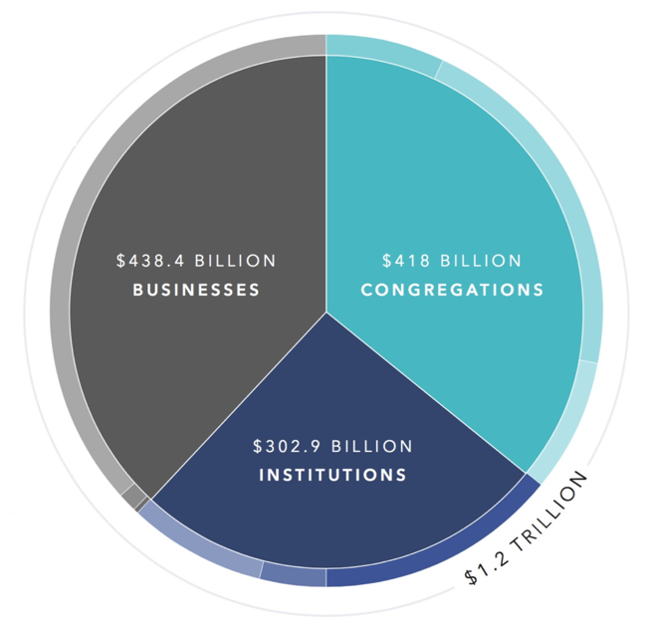
Annual Value of Religion to U.S. Economy

Slide 37
Notes:
Tyson Foods, along with many companies across the country, employs chaplains to minister to the needs of their multi-faith team members. Karen Diefendorf, a retire US Army Command Chaplain, leads their chaplain force. Here’s a short video of their work.

Slide 38
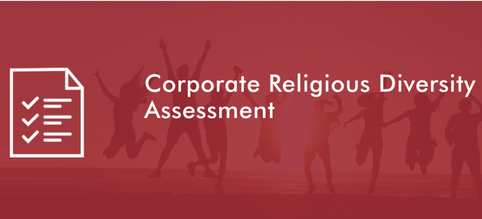
CRDAtool.com
ReligiousFreedomAndBusiness.org/Training
THE FOUR CRITERIA OF THE CRDA
Non-Discrimination and Non-Harassment on the Basis of Religion or Belief
Religious Accommodation and Inclusion
Promoting Sustainable and Innovative Business through Protecting Freedom of Religion or Belief (FoRB)
Protecting and Promoting Freedom of Religion or Belief (FoRB) in Our Communities
Executive Education

Slide 39
Taking the Corporate Pledge
on Religious Diversity & Inclusion
Notes:
I’ll conclude with a call out to numerous companies that have signed the Corporate Pledge on Religious Diversity & Inclusion. In the lunchtime session, we’ll specifically have an opportunity to explore and discuss resources aimed at helping companies fulfill the aspirations of the pledge, which you have a copy of on your chairs. This one minute video is a signing ceremony we held in Korea during the Paralympic Games when we give awards, in partnership with the United Nations Global Compact, for business leaders advancing interfaith understanding and peace – an award TI’s CEO should be nominated for, by the way!

Slide 40
Thank you!
Brian@ReligiousFreedomAndBusiness.org

